Slide 1
Breaking the Flow: Interruptions in Software Engineering
ICSE ’24
Authors: Yimeng Ma, Yu Huang, Kevin Leach
Owen Haynes

Slide 2
Motivation
  Software Engineers experience many interruptions throughout the day this research looks at the impact of interruptions on productivity and stress measures for developers.

Slide 3
Research Questions
  Performance across different software engineering tasks.
  Stress measures across different software engineering tasks.
  The correlation between physiological states and their self-reported feelings.

Slide 4
Study Flow Approach
Pre Survey
Task Block
Interrupt
Post Surveys
Debrief

Slide 5
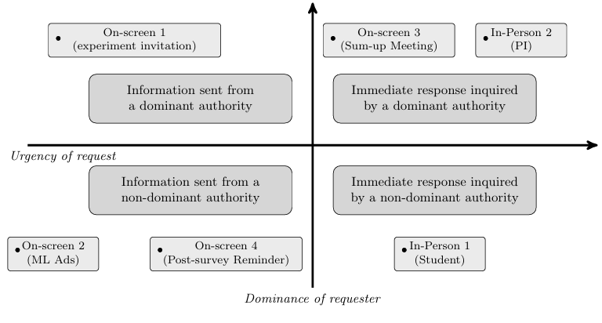
Interruption Types

Slide 6
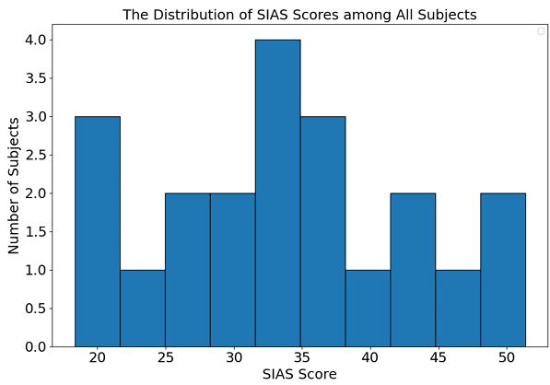
Participant Baseline Anxiety

Slide 7
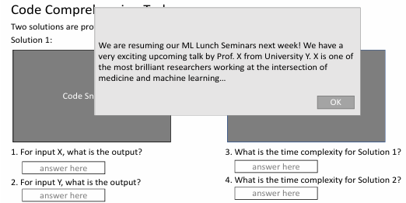
Task Examples

Slide 8
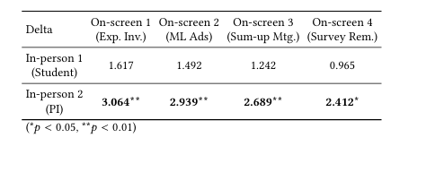
Results: Performance Effects
  High dominance interruptions slowed comprehension by ~164s (p≈0.028).

Slide 9
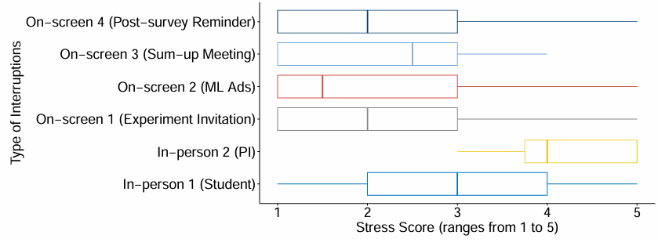
Results: Self Reported Stress

Slide 10
Objective vs Subjective Stress
  HRV increased (SDNN +12ms, RMSSD +14ms) → lower physiological stress.
  However perceived stress increased under dominant interruptions.
  Perceived Stress does not equal physiological stress

Slide 11
Conclusion/Future Work
  Interruption impact depends on dominance & task type.
  Objective and subjective stress diverge significantly.
  Everyday workplace interruption studies.
  Interruption aware IDE tooling.

